Slide 1
GoldenGate
a data replication tool

Slide 2
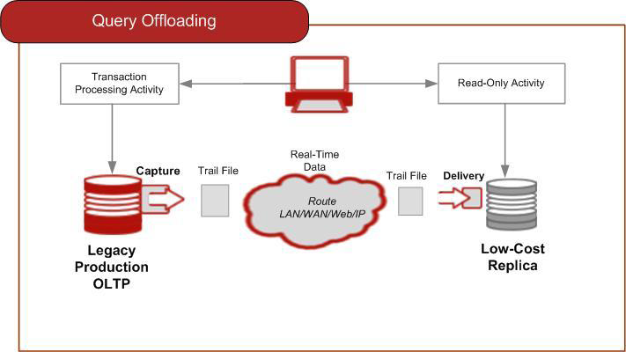
What is GoldenGate
GoldenGate provides low-impact capture, routing, transformation, and delivery of database transactions across heterogeneous environments in real-time

Slide 3
GoldenGate support platform
Operating System
Sun Solaris
Linux
Windows
HP NonStop
HP-UX
HP TRU64
HP OpenVMS
IBM AIX
IBM z/OS

Slide 4
GoldenGate support database
Oracle
IBM DB2
Microsoft SQL Server
Sybase ASE
Ingres
Teradata
Enscribe
SQL/MP
SQL/MX
MySQL
Netezza
Greenplum
ETL products
JMS message queues

Slide 5
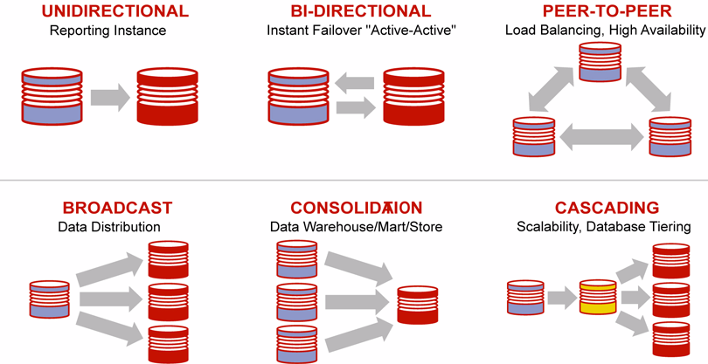
GoldenGate Topologies

Slide 6
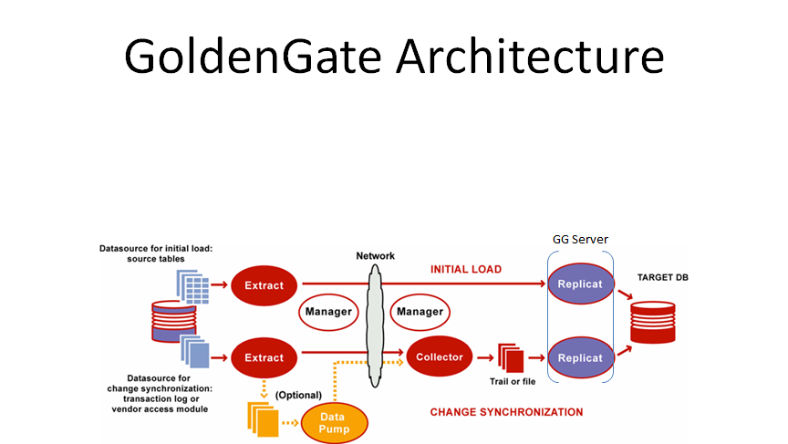
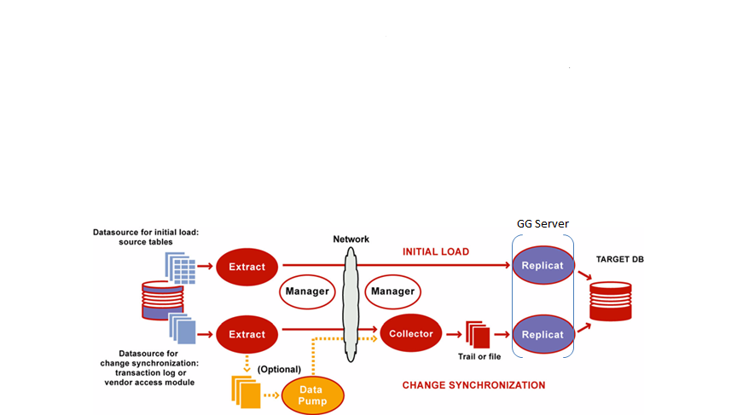
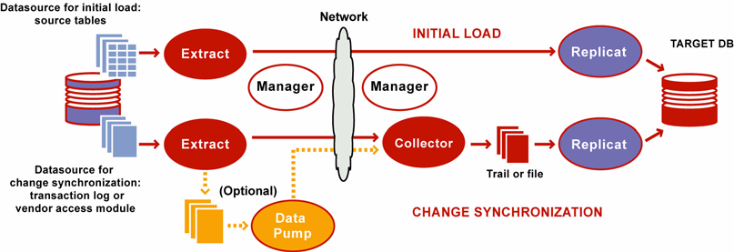
Golden gate Architecture

Slide 7
GoldenGate Component
Manager is the control process of GoldenGate. Manager must be running on each system in the GoldenGate configuration before Extract or Replicat can be started
The Extract process runs on the source system and is the capture mechanism of GoldenGate
The Replicat process runs on the target system. Replicat reads extracted data changes that are specified in the Replicat configuration, and then it replicates them to the target database.

Slide 8
GoldenGate structure
GoldenGate has following default directory
Dirchk - It stores check point info.
Dirdat – it stores remote trail files(.rtf)
Dirdef – It stores def. file which is used for selective replication
Dirout – It stores discarded data.
Dirpcs – GG related pcs files
Dirprm – It stores parameter files(extract/replicat .prm,mgr.prm)
Dirrpt – It stores .rpt files which are log files for GG.
Dirsql - optional
Dirtmp - optional
Dirver - optional

Slide 9
GoldenGate command
Command | Function
ggsci | Start GolenGate console
info all | Get status for processes
start | Start process, manager, extract or replicat
stop | Stop process, manager, extract or replicat
alter | Change process state
stats | Get status
exit | Exit ggsci console

Slide 10
GoldenGate configuration file (prm) I
Manager configuration file, mgr.prm
PORT 9103
DYNAMICPORTLIST 6140-6200
DYNAMICPORTREASSIGNDELAY 5
PURGEOLDEXTRACTS /ggate/payx/dirdat/pxc07q/rt, usecheckpoints
PURGEOLDEXTRACTS /ggate/payx/dirdat/pxc08q/rt, usecheckpoints
PURGEOLDEXTRACTS /ggate/payx/dirdat/pyxq03/rt, usecheckpoints

Slide 11
GoldenGate configuration file (prm) cont…
Extract configuration file, gxXXXXXX.prm
EXTRACT GXPXC01P
setenv (ORACLE_HOME = "/oracle/product/database/1020/db1")
setenv (ORACLE_SID = "pxc01p")
setenv (NLS_LANG = "AMERICAN_AMERICA.WE8ISO8859P1")
setenv (NLS_CHARACTERSET = "WE8ISO8859P1")
userid ggate@pxc01p, password ggate
RMTHOST ggsvr03p, MGRPORT 9103
RMTTRAIL /ggate03/payx/dirdat/pxc01p/rt
NUMFILES 200000

Slide 12
GoldenGate configuration file (prm) cont…
MACRO #includelist185
PARAMS (#schemaname)
BEGIN
TABLE #schemaname.ACCUMULATOR_ADJ;
……
TABLE #schemaname.YTD_ACCUMULATOR;
END
#includelist185(VPDCLSCH0010000018)
#includelist185(VPDCLSCH0020000022)
#includelist185(VPDCLSCH0030000010)

Slide 13
GoldenGate configuration file (prm) cont…
Replicat configuration file, gxXXXXXX.prm
REPLICAT grpxc01p
setenv (ORACLE_HOME = "/oracle/product/client/1020")
setenv (ORACLE_SID = "crr01p")
setenv (NLS_LANG = "AMERICAN_AMERICA.WE8ISO8859P1")
userid ggate@crr01p, password ggate
DISCARDFILE /ggate03/payx/dirout/grpxc01p.dsc, PURGE MEGABYTES 200
REPERROR DEFAULT, DISCARD
NUMFILES 200000
WILDCARDRESOLVE DYNAMIC
ASSUMETARGETDEFS

Slide 14
GoldenGate configuration file (prm) cont…
MACRO #rep_payxr185
PARAMS (#sschema, #tschema)
BEGIN
INSERTAPPEND
MAP #sschema.ACCUMULATOR_ADJ, TARGET #tschema.ACCUMULATOR_ADJ, KEYCOLS (oid, vpd_key);
……
MAP #sschema.YTD_ACCUMULATOR, TARGET #tschema.YTD_ACCUMULATOR, KEYCOLS (oid, vpd_key);
END;
#rep_payxr185(VPDCLSCH0010000018, PAYX_REG01_POD30_CRU20P)
#rep_payxr185(VPDCLSCH0020000022, PAYX_REG02_POD30_CRU20P)
#rep_payxr185(VPDCLSCH0030000010, PAYX_REG03_POD31_CRU20P)

Slide 15
PayX Replication
GG Svr 03 - 04
pxc01p
cru21p

Slide 16
ezLM Replication
GG Svr 01 - 04
cru11p

Slide 17
ACS Replication
prt21p
GG Svr 01
cru21p

Slide 18
Registry Replication
reg11p
GG Svr 01
cru40p

Slide 19
Etime Replication
GRET013P
GG Svr 04
cru11p

Slide 20
TS Replication
GRPEOP01
GG Svr 01
cru21p

Slide 21
Naming convention
Replicat : GRPXC01P (pxc01p is the instance name running at source)
Extract: GXPXC01P (pxc01p is the instance name running at source)
Manager: mgr.prm (It’s same at source and target)

